Slide 1

What I Learned from the Artificial Intelligence Course
Exploring the theory, algorithms, and practical implementation of intelligent systems through coursework and hands-on projects.
Presented By:
Afifa Islam Chy Sabiha
Id: 0562320005101068
Course Code: CSE-06133115(Theory) & CSE-06133116(Lab)

Slide 2
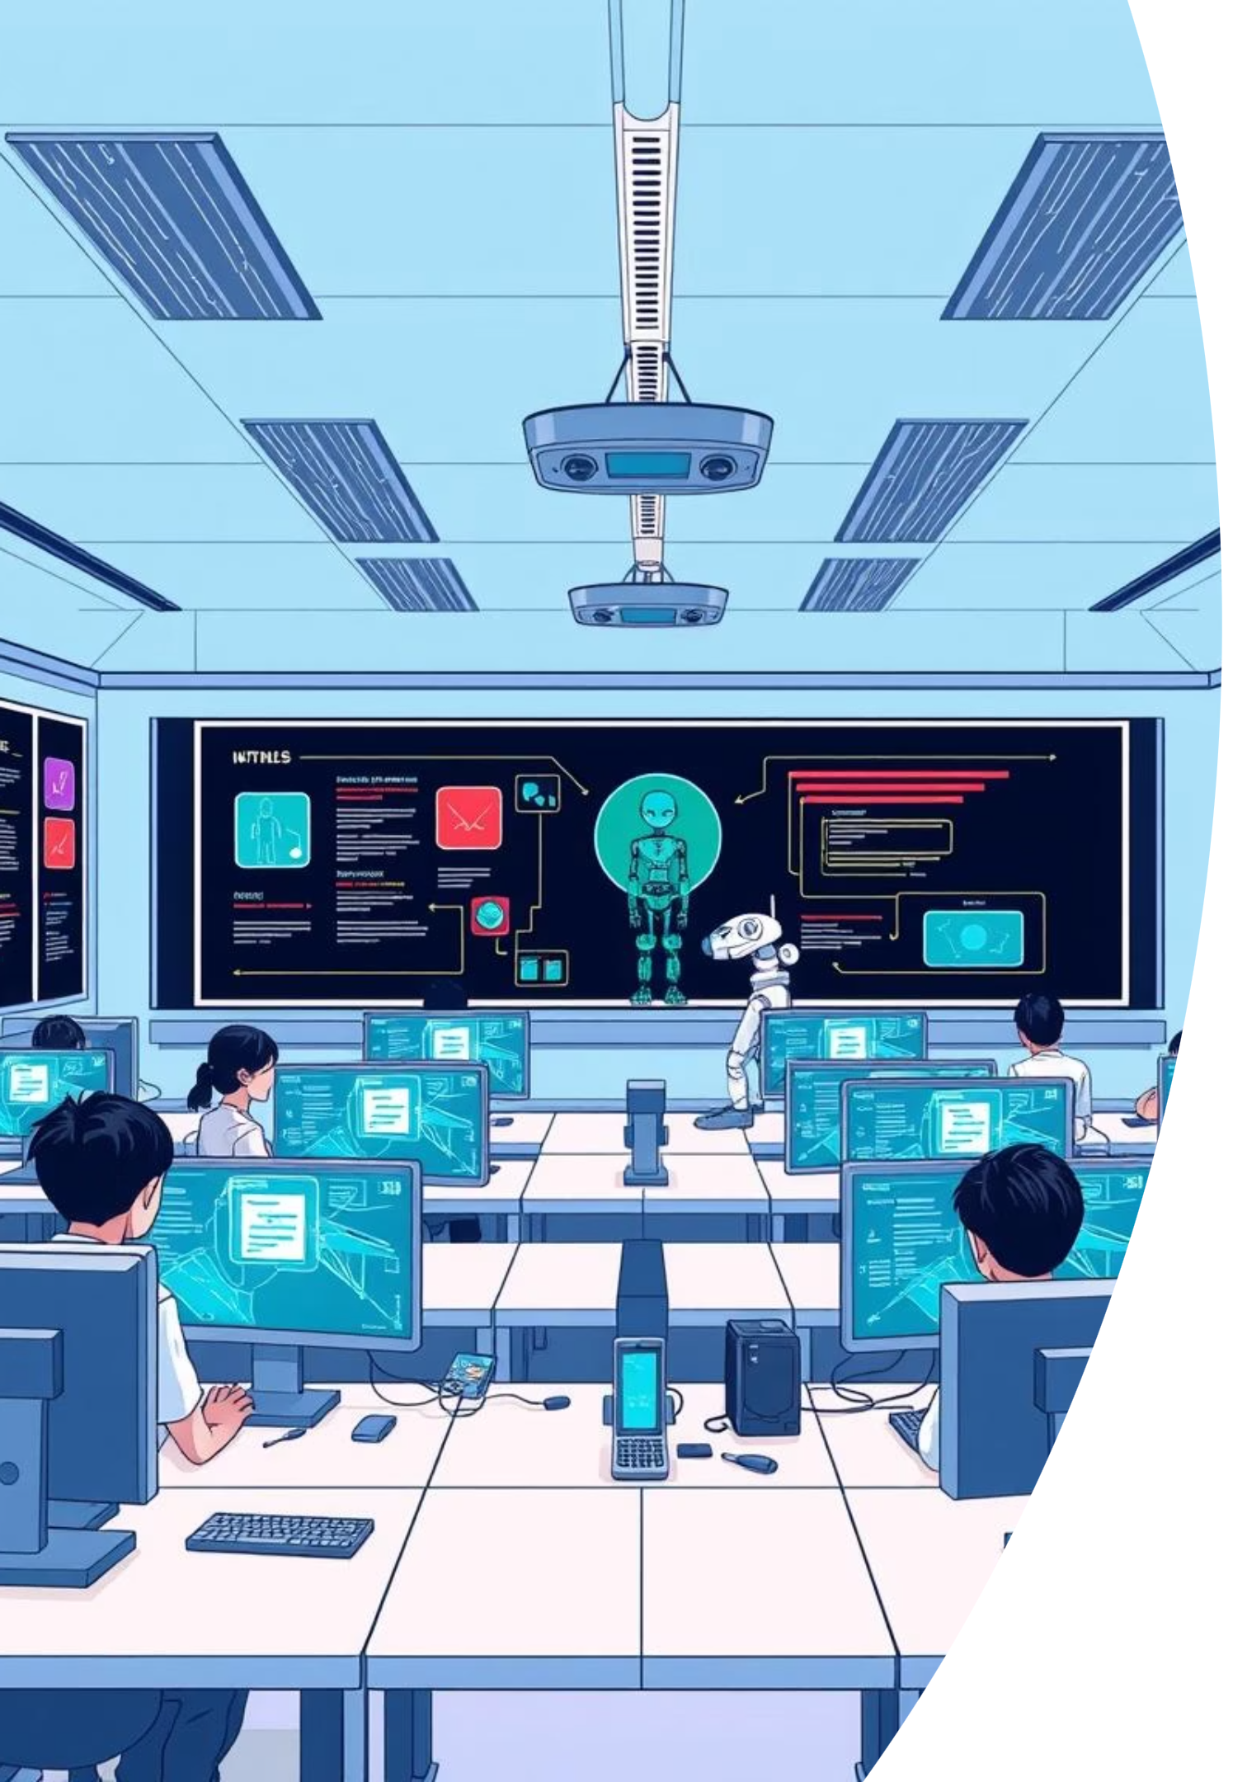
Course Overview
Theory Foundations
Practical Implementation
Core AI concepts, search algorithms, and game-playing strategies
Building intelligent systems using Python and advanced algorithms
Real-World Applications
Games, optimisation, and constraint satisfaction problems

Slide 3

Foundations of Artificial Intelligence
What is AI?
Key Goals
Artificial intelligence focuses on creating systems that can perceive their environment, learn from experience, and make intelligent decisions to achieve specific goals.
Simulate human intelligence
Solve complex problems efficiently
Enable autonomous decision-making

Slide 4





Agents and Environments
Understanding how intelligent agents interact with their surroundings is fundamental to AI design.
Agent
Environment
Perceives and acts within an environment
External world with properties and dynamics
Actions
Sensors
Responses that affect the state
Percepts from the environment

Slide 5

Search Algorithms: Finding Solutions
Search strategies explore possible solutions systematically. Uninformed search methods explore blindly without domain knowledge.
Breadth-First Search
1
Explores all nodes at current depth before moving deeper
Depth-First Search
2
Explores as far as possible along each branch
Iterative Deepening
3
Combines benefits of BFS and DFS approaches
Bidirectional Search
4
Searches from goal and start simultaneously

Slide 6
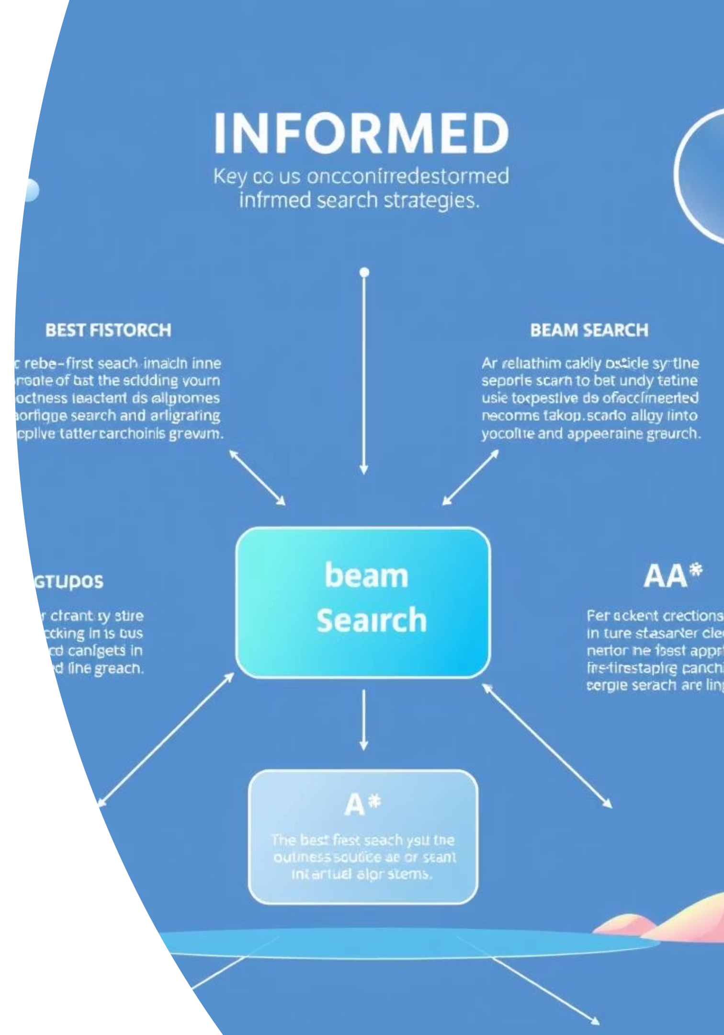
Informed Search: Using Knowledge
Informed search strategies use heuristic information to guide the search more efficiently toward the goal.
Best-First Search
Beam Search
Expands nodes with best heuristic value first, prioritising promising candidates.
Limits search width by keeping only the k most promising nodes at each level.
A* Algorithm
Combines actual cost and heuristic estimate, balancing optimality with efficiency for optimal pathfinding.

Slide 7
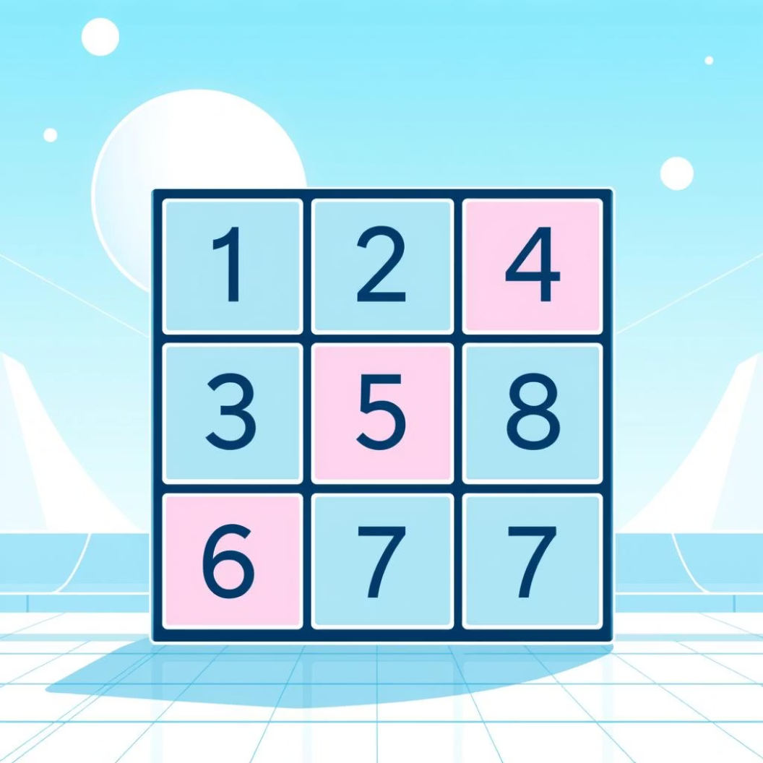
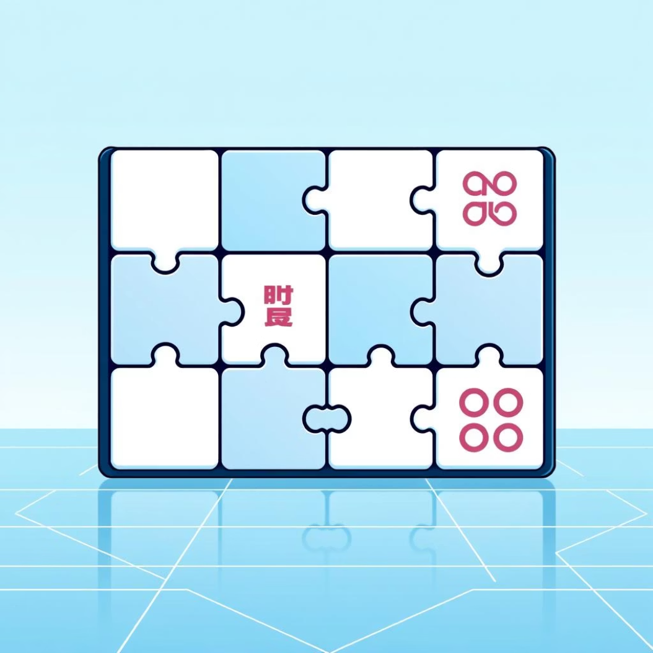
Classic Problem: The 8-Puzzle
Problem Description
The 8 Puzzle Problem is a classic problem in artificial intelligence (AI) and is often used to teach problem-solving techniques, particularly in the areas of search algorithms and heuristic optimization. It consists of a 3x3 grid with 8 numbered tiles and one empty space, where the objective is to move the tiles around to match a predefined goal configurationA
Learning outcome: Understanding heuristics like Manhattan distance and implementing efficient search strategies to solve real optimisation problems.

Slide 8
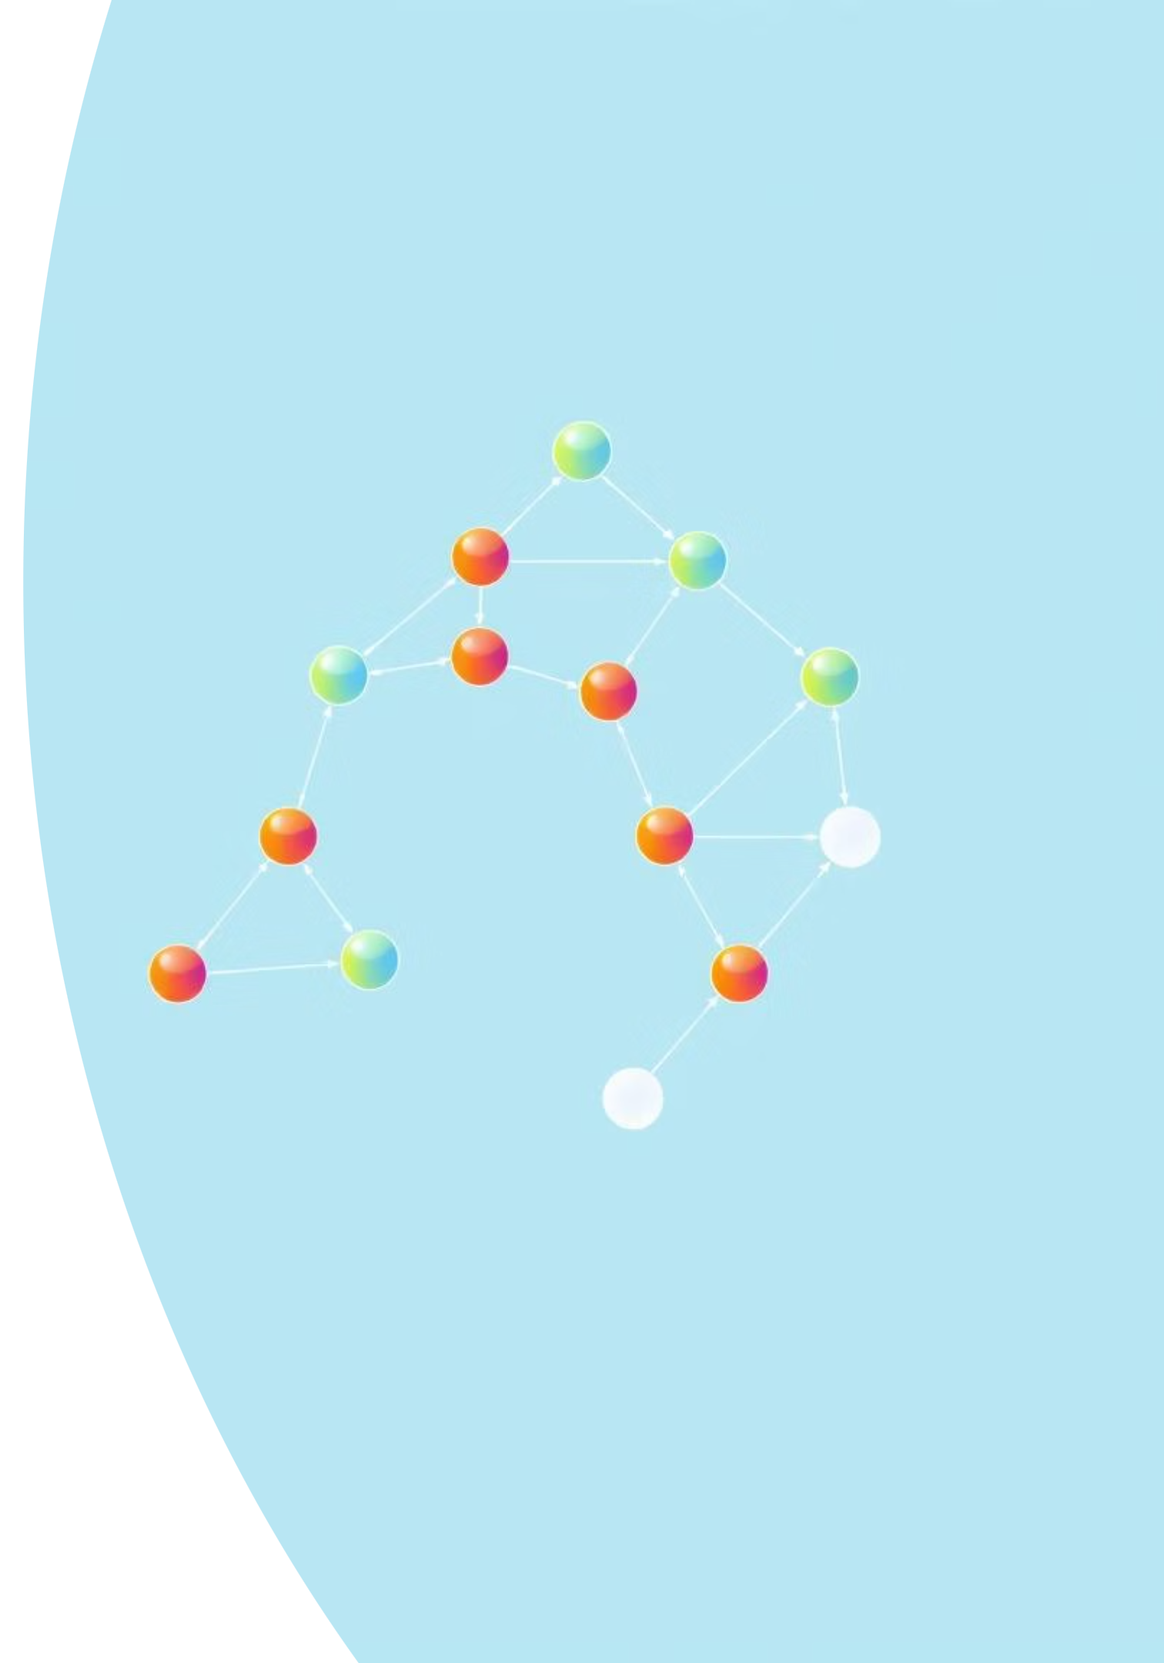


Game-Playing Algorithms
Adversarial search enables systems to compete intelligently against opponents by evaluating possible moves and consequences.
Minimax
Explores game tree assuming opponent plays optimally; maximises own score whilst minimising opponent's.
Alpha-Beta Pruning
Optimises minimax by eliminating branches that cannot influence final decision, reducing computation dramatically.

Slide 9
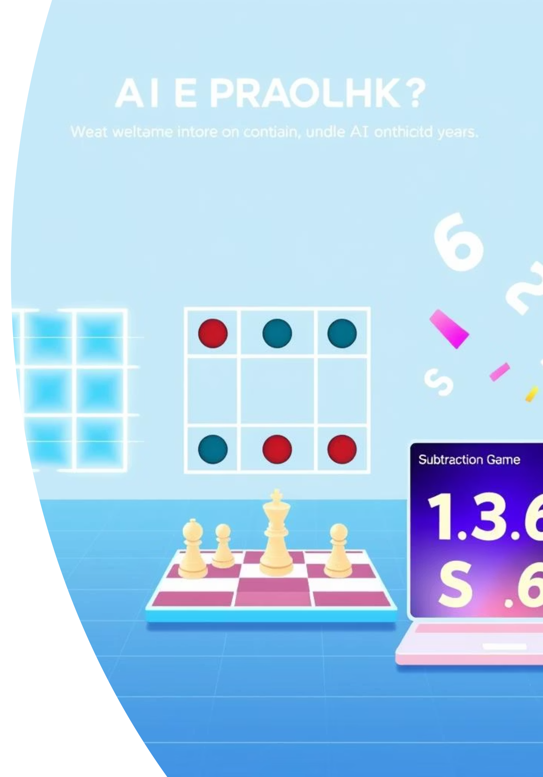
Hands-On Implementation: Python Projects
Theory comes alive through practical implementation. Three projects demonstrated core game-playing algorithms:
1
Tic-Tac-Toe Game
Built an unbeatable AI opponent using minimax algorithm with perfect game-tree evaluation and optimal move selection.
2
Chess Implementation
Implemented board representation, move generation, and evaluated positions using alpha-beta pruning for efficient search.
3
Two-Player Subtraction Game
Developed intelligent agents that use game algorithms to maximise winning chances through strategic analysis.

Slide 10
Key Takeaways
Search Matters
Choosing right strategy impacts efficiency dramatically.
Heuristics Help
Domain knowledge guides search more effectively.
Games Teach AI
Adversarial problems reveal core AI principles.
Implementation Solidifies Understanding
Building systems reveals theory's practical power and limitations.

Slide 11

Thank You
(A special thanks to the course instructor
Mr. Razorshi Prozzwal Talukder Sir,
for making AI simple and inspiring.
It was a wonderful experience learning and
applying AI concepts.)

